Slide 1
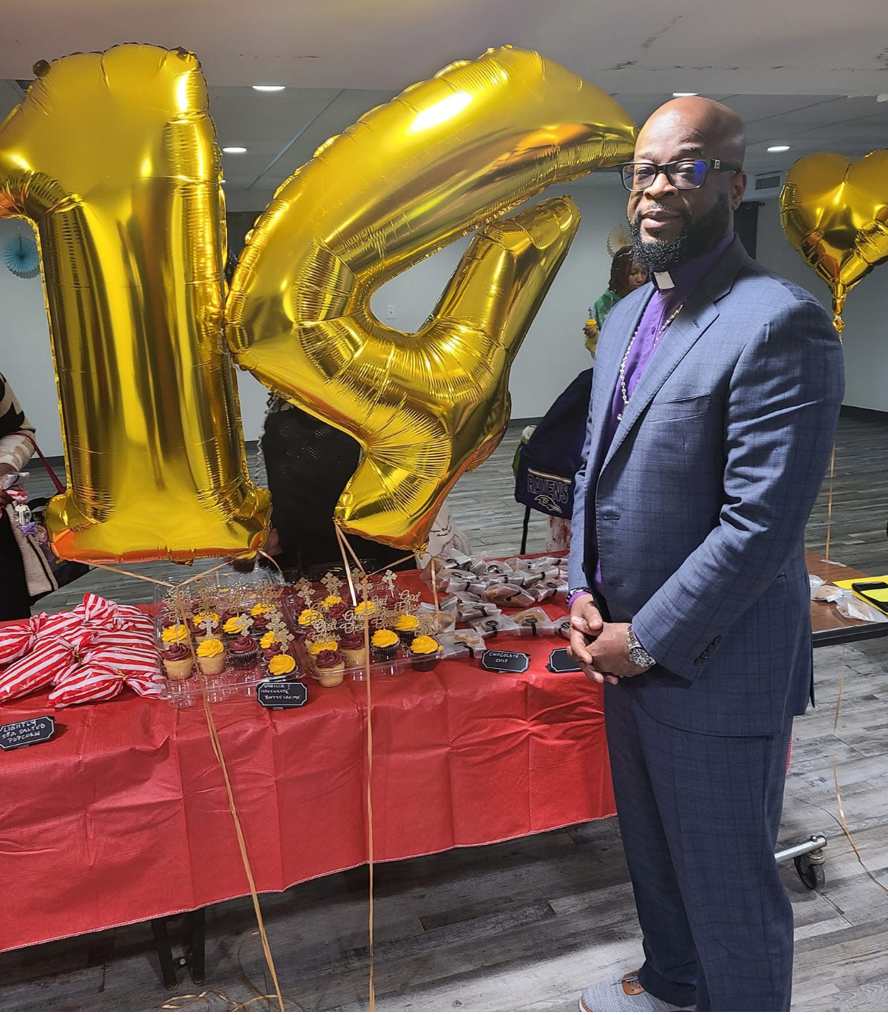
We Welcome You!
Mt. Jezreel
Baptist Church
Rev. Anthony T. Oliver, Pastor

Slide 2
Tuesday noon day Prayer CALL @ 12:00p.m. (noon) Call#:
725-735-9830

Slide 3
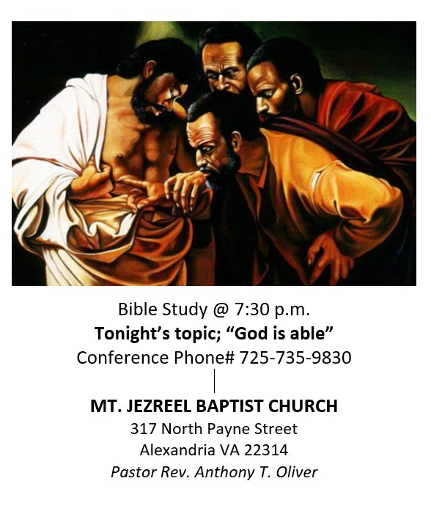
Wednesday night bible study
@7:30p.m. on Wednesdays
Facebook @mount Jezreel Baptist church
(stay alert for updates)
Instagram- @mjbc317
Call#: 725-735-9830
Last Wednesdays of the month in person! TBA

Slide 5
Please have your child(ren) dress down 1st , 2nd, 3rd and 5th Sundays!

Slide 6
Next meeting March 1st @ Noon!

Slide 7
Next Rehearsal:
April 5, 2025

Slide 8
OFFERING- GIVELIFY APP
Mt. Jezreel Baptist Church
ALEXANDRIA, VA
CHURCH OFFERING ON WEBSITE- COMING SOON!

Slide 9
CONTACT US
FACEBOOK- MOUNT JEZREEL BAPTIST CHURCH
WEBSITE: www.mountjezreelbaptist.org
INSTAGRAM- @MJBC317
CHURCH PHONE NUMER: 703-564-4850
CHURCH EMAIL: mjbcva.703@gmail.com

